Slide 1
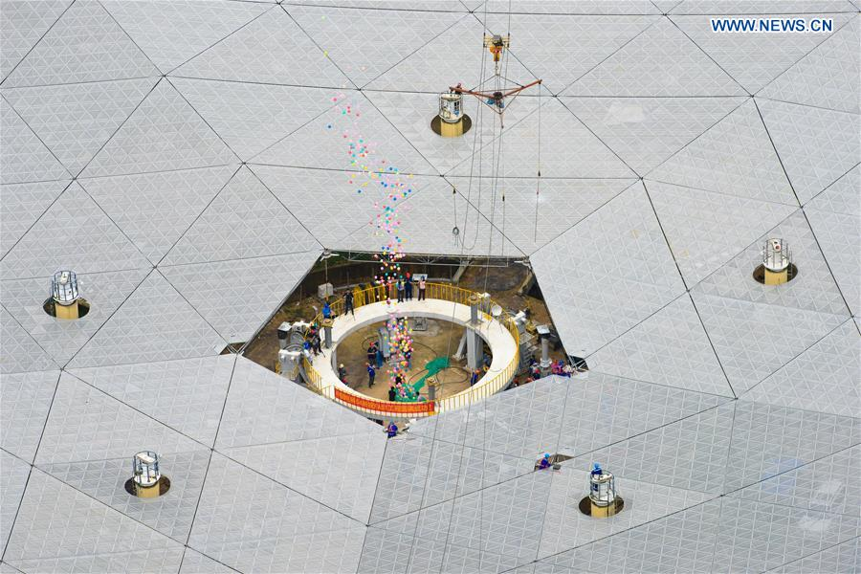

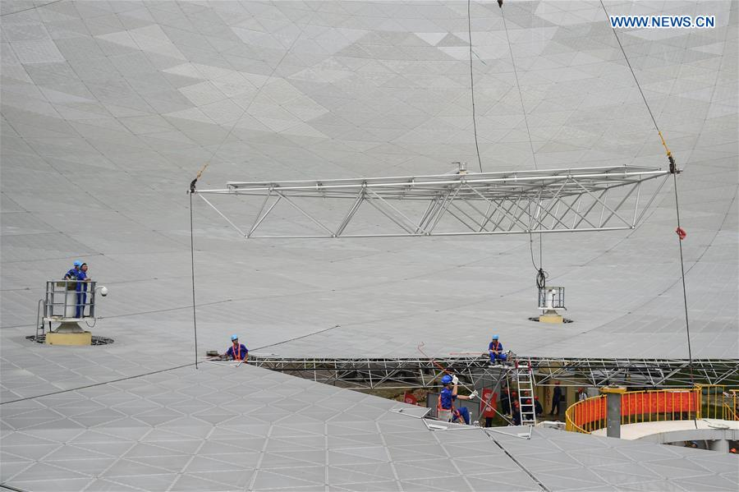

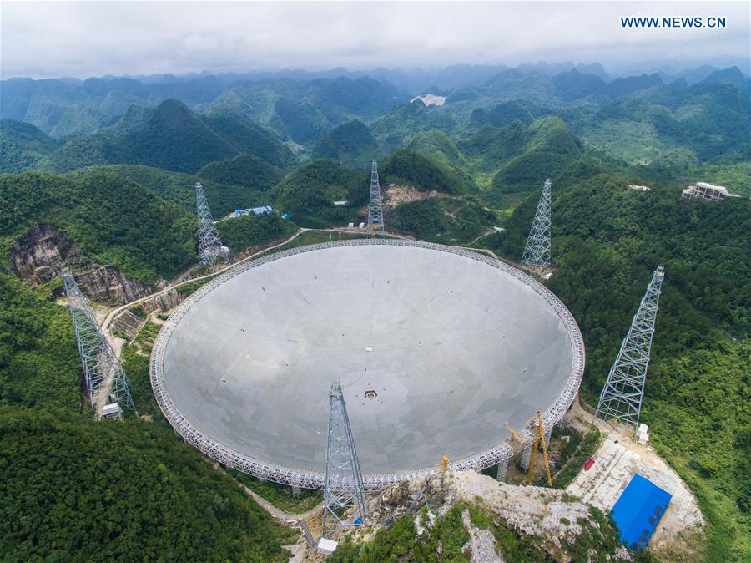
Notes:
Construction is complete on the now largest radio telescope in the world, built in China’s Guizhou Province. The antenna spans 1650 feet, 65% larger and about 2 ½ times as sensitive as the previous record holder, the Arecibo telescope in Puerto Rico. It is constructed of over 4000 individual panels. It will enter a testing phase for the next few years, then be available for international usage to study the structure of the universe as well as help in the search for aliens. There was some controversy internationally over the construction of the telescope, as a small village of 65 people was located at the site. The villagers were moved in 2009. Chinese media reports that “they [now] enjoy better living standards [and] villagers in nearby communities admired [the luck of those who moved], saying they should "thank the aliens."

Slide 2

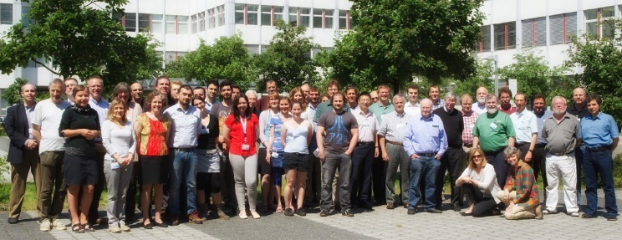
Video edited for length and to remove sound.
Notes:
Last month Nasa released a spectacular series of images of the minor planet Ceres, which the Dawn spacecraft has been studying for the last year. This is a video created by the Dawn mission team that simulates the appearance of the planet based on the thousands of images and gigabytes of data that Dawn sent back to Earth. In this video, surface features have been enhanced to show more detail. Dawn’s primary mission ended on June 30, but it will remain at Ceres and continue collecting data through 2017.
2

Slide 3
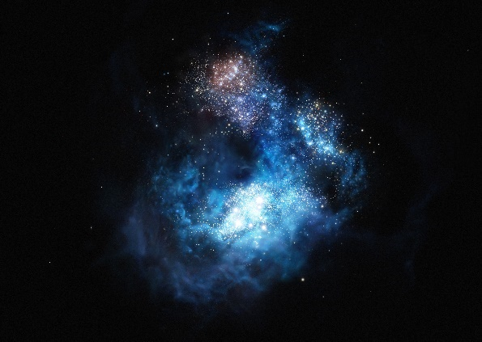
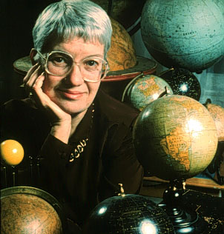
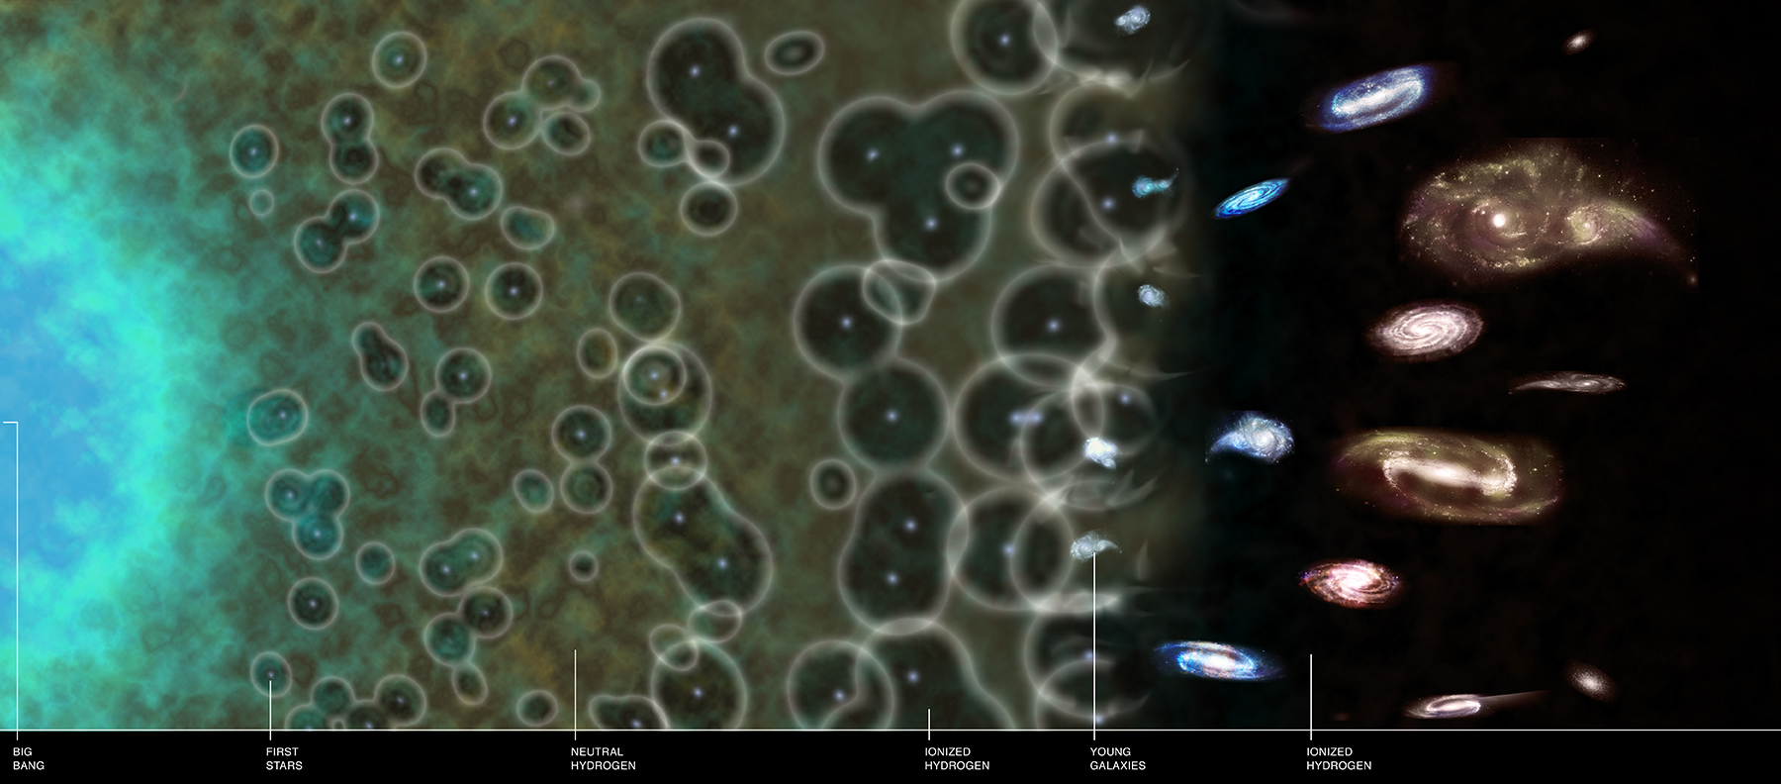
Notes:
A team of astronomers announced the discovery of three galaxies that are just emerging from the cocoon of hydrogen that surrounded it in the early universe. Before these stars formed the universe consisted of almost entirely neutral hydrogen, which doesn’t allow some ultraviolet light to escape and traps the heat in the gas. When the first stars manage to form they being ionizing bubbles of this gas around them. Eventually, there are enough stars that the gas becomes entirely ionized, letting through the ultraviolet light. These five galaxies are being seen just as the last remnants of the neutral hydrogen persist. Shown here is the first of these types of galaxies, CR7 (the dark smudge in the middle of the picture on the top right), one of five galaxies announced that are likely to be filled with some of the first stars that formed in the universe. The fifth of these galaxies has been dubbed VR7, named after Vera Rubin, whose work was monumental in establishing the existence of dark matter.
3

Slide 4
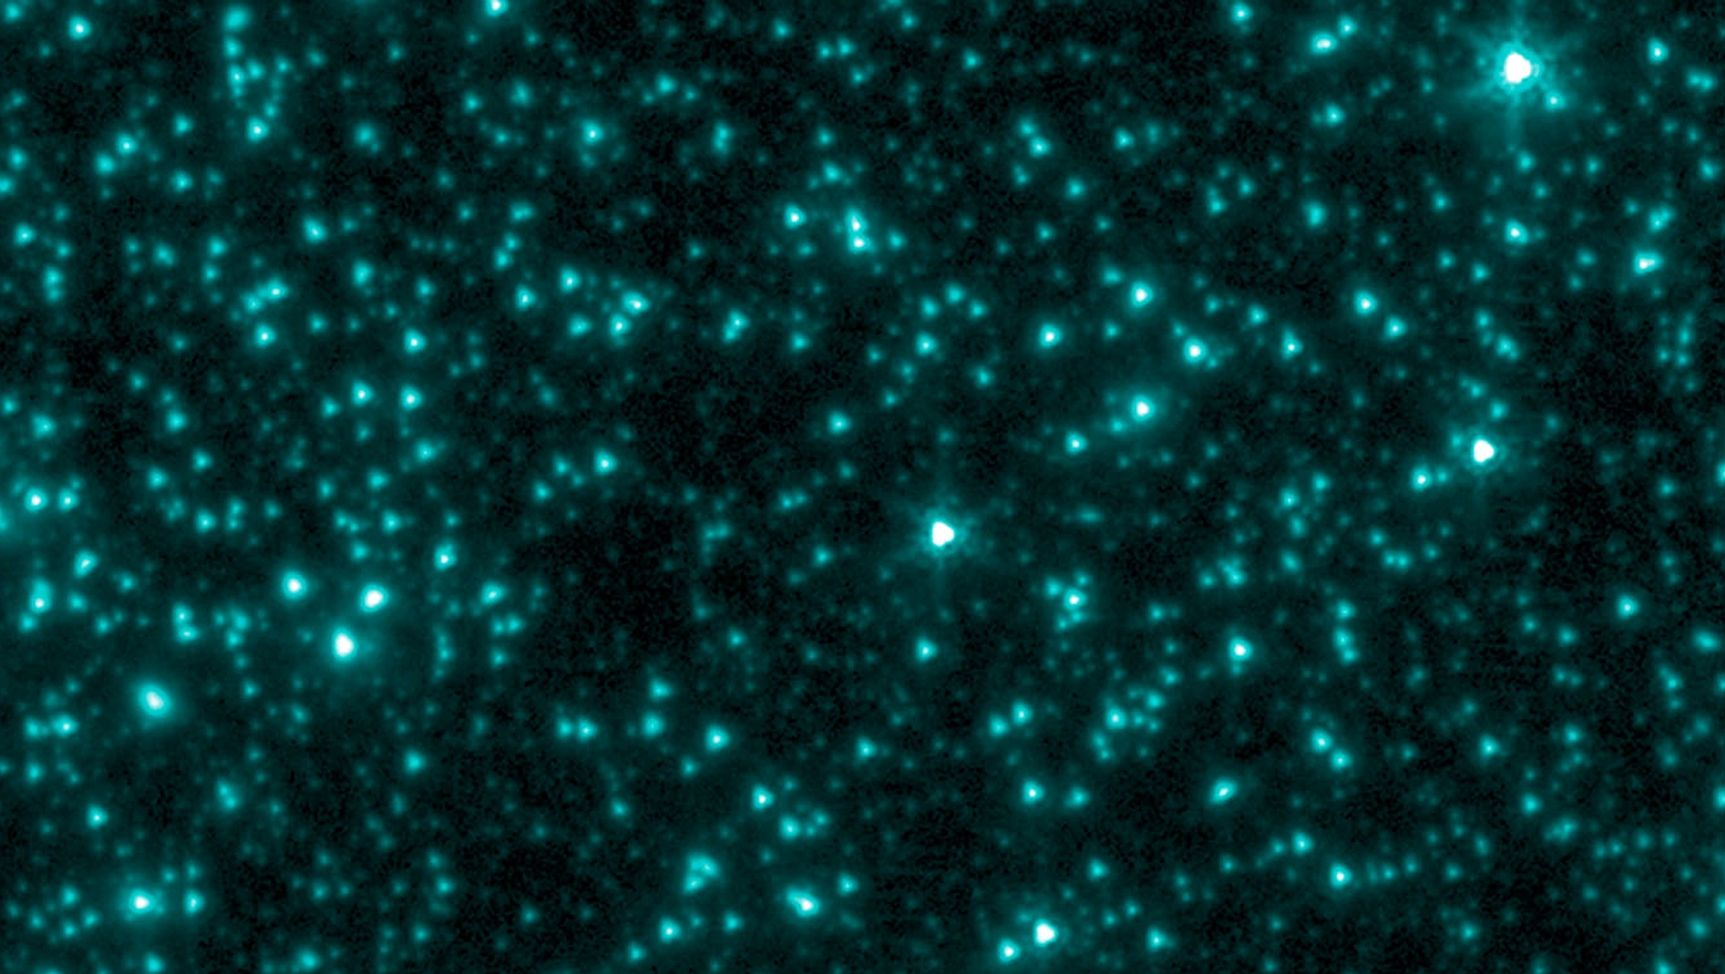
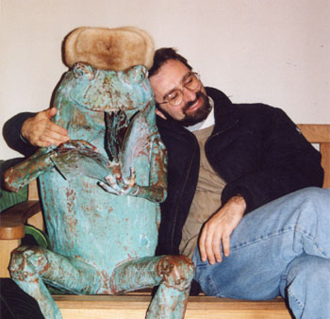
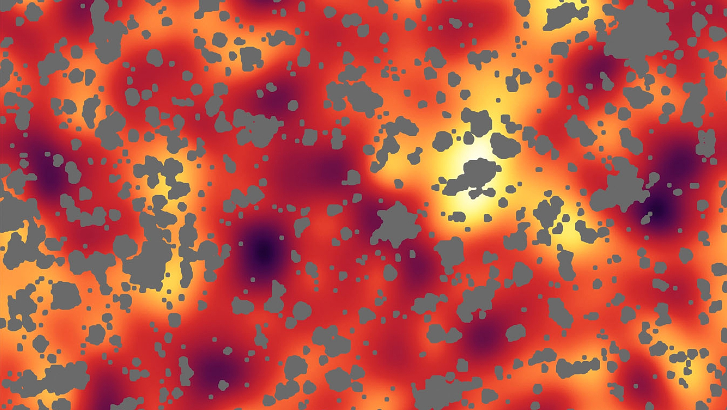
Notes:
Alexander Kashlinsky of the Nasa-Goddard Space Flight Center has proposed that dark matter may consist of black holes formed early in the universe, within the first 300 million years after the Big Bang. These black holes would not have formed through gas becoming stars, but rather by collapsing directly into black holes. Shown here on top is a view of a part of the sky in the infrared, then below is the same image with all of the stars removed, showing the background glow of the universe in the infrared. Black holes with a mass of about 30 times that of our Sun would naturally explain clumpiness that is seen in this glow. This mass is also similar to that of the black holes detected by LIGO last September, which may explain why such massive black holes exist in the first place.
4

Slide 5
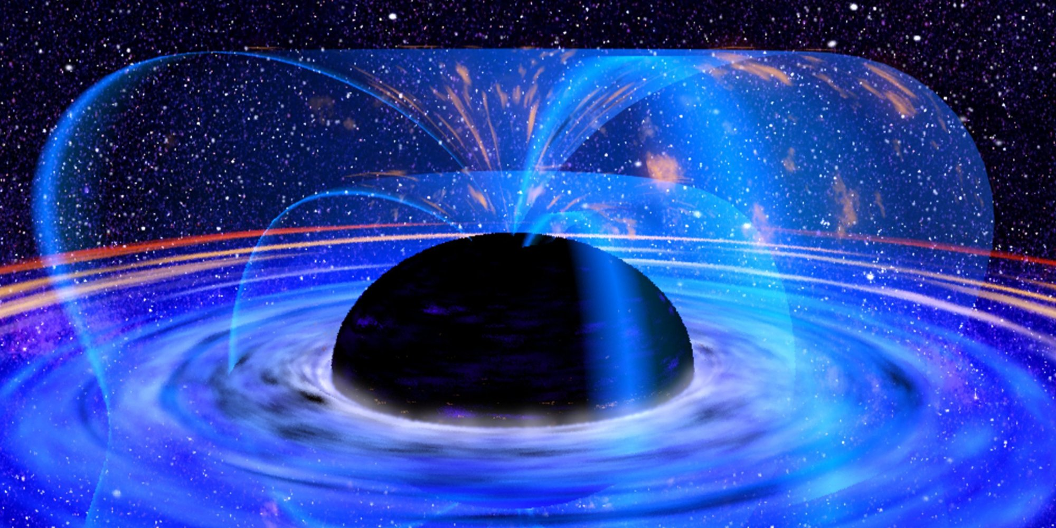

Notes:
In May a paper suggesting that black holes have “soft hair” was published by Stephen Hawking in collaboration with Malcolm Perry of Cambridge and Andrew Strominger of Harvard, none of whom are completely bald. Having soft hair means that the information about the material that has been trapped in the black hole is stored in a thin layer just outside the black hole. This is in contrast to ideas about black holes developed in the 1970s which required black holes to have “no hair”, and are defined only by their mass, spin, and electric charge. Hawking and his collaborators are not the first to suggest that black holes have any form of “hair”, and all attempts to claim the presence of such, including this recent study, have been controversial. LIGOs detections of gravitational waves will provide more information about which side in this debate is right.
“Bearded” black holes, as proposed by Austin hipsters, have yet to gain traction in the field.
5

